Slide 1
An Introduction to Ergonomics
This material was produced under grant [SH20856SH0] from the Occupational Safety and Health Administration, U.S. Department of Labor. It does not necessarily reflect the views or policies of the U.S. Department of Labor, nor does mention of trade names, commercial
products, or organizations imply endorsement by the U.S. Government
Notes:
Introduce yourself and give background about yourself and why this training is going on.
Have the students introduce themselves with names, job title and years with the company.
Record their info on white board or paper
When the room has finished, total up the years experience in the room.
Explain to them that their total years far out weighs your own and that you’ll be relying on their own work experience and knowledge to help teach the class.

Slide 2
Pre-Quiz
Take a few minutes and answer the quiz
questions to the best of your ability

Slide 3
What is Ergonomics?
“The scientific discipline concerned with understanding of interactions among humans and other elements of a system, and the profession that applies theory, principles, methods and data to design in order to optimize human well-being and overall system performance”.
Ergonomics means
“fitting the job to the worker”
From the Greek
Ergo = Work
Nomos = Laws
Source : International Ergonomics Association (IEA) in 2000

Slide 4
Benefits of ergonomics
Helps to prevent injuries
Improve quality of work and life
Reduce fatigue and discomfort
Increased productivity and efficiency
Improved morale and job satisfaction
Reduced turnover
Notes:
So, we can see that ergonomics isn’t just a science, it’s a tool; a tool that can be used to improve jobs and make them safer.
Changing your job so that it better fits you has other benefits as well. You might find that you’re able to do a better job because you have more energy and can concentrate on your work. You might also be less tired at the end of the day, so you can enjoy life outside of work more.
Remember, there are a lot of changes that you can make to the way you do your job that will make it both safer and better.

Slide 5
What are Work Related Musculo-Skeletal Disorders (WMSDs)?
WMSDs are also known as:
  Cumulative Trauma Disorders (CTDs)
  Repetitive Strain Injuries (RSIs)
  Overuse injuries
They are soft tissue injuries which occur gradually
Notes:
These injuries are called work-related musculoskeletal injuries, or WMSDs. You may have heard of these injuries by another name, such as MSD’s which are the same as WMSD’s, but they don’t happen as a result of work related issues, cumulative trauma disorder, or CTD; repetitive strain injury, or RSI; or overuse injuries. WMSDs affect the soft tissues of the body - the muscles, tendons that connect muscles to bones, ligaments that connect bone to bone, nerves, blood vessels, pretty much every part of your body that’s not a bone or internal organ.
These are the parts of your body that are prone to injury when demands on them go beyond what they can handle. Typically these injuries occur in your body’s joints, the moving parts of the body like your low back, wrist, shoulder, elbow and knee. These are the parts of your body that get used the most and that are placed under the most stress during the day.
Often these injuries start out small, as a little muscle pull or a slightly irritated tendon. However, if a small injury isn’t given a chance to heal, it can become aggravated, especially if you keep doing the activity that caused the injury in the first place. Over time, these small injuries can build until they become chronic, and at this point they become a WMSD.
Refer to the NIOSH definition of MSD and WMSD:
MSDs refer to the disorders of the muscles, nerves, tendons, ligaments, joints cartilage, or spinal disks. These disorders are not result of any instantaneous event such as slip or fall but reflect a more gradual or chronic development. These are disorders that diagnosed by a medical history, physical examination, or other medical tests and they can range in severity from mild and intermittent to debilitating and chronic. These are disorders with several distinct features (such as carpal tunnel syndrome) or disorders defined primarily by the location of the pain (such as low back pain).
b) WMSDs refer to MSDs to which the work environment and the performance of work contribute significantly or MSDs that are made worse of longer lasting by work conditions.

Slide 6
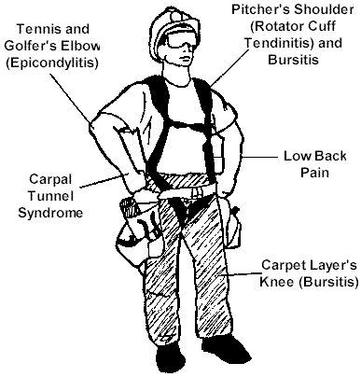
WMSDs
WMSDs are occupational disorders of the soft tissues:
  muscles
  tendons
  ligaments
  joints
  blood vessels
  nerves
  spinal disks
Notes:
Work-related musculoskeletal disorders, or WMSDs, are injuries that occur to the soft tissues of the body – the muscles, tendons (attach muscle to bone), ligaments (attach bone to bone), joints, blood vessels and nerves.
These injuries can include rotator cuff injuries and bursitis in the shoulder, epicondylitis (a form of tendinitis) in the elbow, carpal tunnel syndrome in the wrist, low back pain and bursitis of the knee.
WMSDs tend to occur gradually, accumulating from months or even years of work, as opposed to sudden injuries such as a broken bone due to a fall or a neck injury from a motor vehicle accident.

Slide 7
Ways WMSD’s injure the body:
  Muscles: can be strained or torn.
  Tendons: can be strained, torn or inflamed. Tendons attach muscle to bone.
  Tendon Sheaths: can be inflamed. Tendon sheaths are the protective wrapping for the tendons, which contain fluid so that the tendon can slide back and forth within the sheath
  Nerves: can be pinched
  Ligaments: can be sprained or fibers torn from the bone. Ligaments attach bone to bone
  Discs: can slip or bulge. Discs are the shock absorber between the vertebrae of the spine

Slide 8
What are some of the symptoms of WMSDs?
Discomfort
Pain
Numbness
Tingling
Inflammation
Burning
Swelling
Change in color
Tightness, loss of flexibility
Notes:
WMSDs have many different symptoms, many of which you may have experienced at one time or another. These include discomfort, pain, numbness, tingling or burning sensations, swelling and inflammation, changes in skin color, and tight muscles or loss of flexibility in a joint. Having one or more of these symptoms doesn’t necessarily mean you have an injury, though.
Everyone has had muscle aches or stiffness after working or exercising hard, especially when you’re not used to it. Usually these symptoms go away as you rest or as you get used to the work. That’s different from symptoms of injury, which last longer or include things like numbness and tingling that mean something more serious might be going on. Sometimes these symptoms might make it difficult to do your job or things around the house, or they might wake you up at night and keep you from getting a good night’s sleep. The important thing is not to ignore what your body is trying to tell you. Often simple changes to the way you work are all that are necessary to prevent these symptoms from becoming a WMSD.

Slide 9
What causes WMSDs?
  Heavy, Frequent, or Awkward Lifting
  Pushing, Pulling or Carrying Loads
  Working in Awkward Postures
  Hand Intensive Work
  Vibration
  Contact Stress
Notes:
There are many things that everyone does on the job and at home that could contribute to a WMSD if they are done for long enough periods of time. These activities are called risk factors. Risk factors include heavy, frequent or awkward lifting, pushing, pulling or carrying, working in awkward postures, and hand intensive work that requires the use of high hand forces and repetitive motions. Also, vibration, both hand and whole body and contact stress (direct or continuous contact with hard or sharp objects or surfaces such as non-rounded desk edges or unpadded tool handles or other work objects that create pressure over an area of the body) can cause WMSD’s.

Slide 10
Risk Factors
Risk of injury depends upon:
  Duration of exposure
  Frequency of exposure
  Intensity of exposure
  Combinations of risk factors
(how
long)
often
(how
often)
often
MUCH)
(how
+++
Notes:
Just because your job has risk factors, doesn’t mean that you’re going to have a WMSD, though. In fact, a little bit of exposure to some risk factors can actually be good for you. Occasionally moving into awkward postures like reaching or bending will help to stretch and exercise your muscles.
Also, if you occasionally do some lifting, especially if you do it properly, it can help to strengthen your muscles. This is the whole point behind exercising.
Whether or not a risk factor will result in a WMSD depends on the duration, or how long you are exposed to it; the frequency, or how often you are exposed to it and how much rest you get in between; and the intensity, or how much of the risk factor there is (for example, how heavy is the object you lift, or how far over you have to bend to pick it up), and combinations of risk factors, where you are exposed to more than one risk factor at a time. The more risk factors you have at once, the more likely an injury will occur.
Next, we’ll take a look at each risk factor a little more closely.

Slide 11
Duration
Duration – the length of exposure to a risk factor (usually need hours of exposure before risk factors become a concern).
Can be all at one time or cumulative over the day
Notes:
You need to be exposed to risk factors for quite a while before you can be injured by them. Remember, we’re talking about hours of exposure here, not just minutes.
You don’t need to be exposed to a risk factor for hours on end to increase your chance of being injured, though. For example, it’s easy to see how working bent over for two hours straight could cause back strain. While it’s less likely to cause an injury, you can also strain your back by working bent over 15 minutes at a time for a total of two hours per day.
Something to keep in mind, it’s not that these injuries occur from a single day of exposure. It’s when you have these risk factors as a regular part of your job with multiple days of exposure that injuries can occur.

Slide 12
Frequency
Frequency is often a concern in:
Assembly tasks
Sorting tasks
Loading or off-loading materials
Inventorying products
Product stocking
Keying/typing or frequent mousing
Notes:
Frequency addresses the speed at which you work. It can be measured in units per unit time (ie.boxes per hour). Some people get paid by the product amounts they assemble, pick, load, unload, stack, etc. With numbers as a motivator, sometimes repetition can be dangerous. When combined with force, and duration, doing a task with high frequency can significantly increase a person’s potential for injury. What can be defined as frequent, changes with the nature of the task. Lifting 30 lb boxes more than 5 times a minute can be considered frequent, while typing more than 5 words a minute probably wouldn’t. Use your good judgement to determine what is frequent for the various tasks in your workplace.

Slide 13
Intensity
Intensity refers to:
weight in pounds of items lifted or carried
grip or pinch force of lifted or manipulated items
vibration
force on keys when typing

Slide 14
Risk factors for WMSDs
Heavy, frequent or awkward lifting
Notes:
Heavy, frequent or awkward lifting

Slide 15
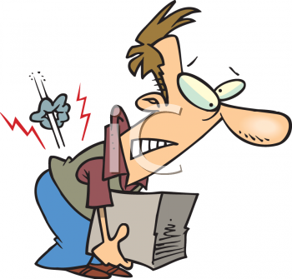
Heavy lifting
There are only recommendations for maximum weight a person can lift.
Notes:
Most people are aware that lifting heavy objects increases the risk for injury. The load on the low back when lifting something heavy can strain the muscles and damage the disks in your spine. The load can strain the muscles in the shoulders and upper back as well.
Refer to the NIOSH lifting equation but explain that it only works in controlled situations.

Slide 16
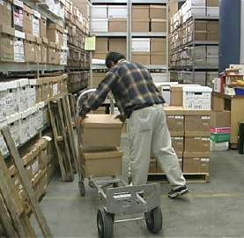

Frequent lifting
Lifting more than twice per minute
Notes:
Fewer people know that repetitive lifting can be just as hazardous because of the fatigue it causes. When you lift frequently you can tire out the muscles, making them more prone to injury. If your muscles can’t handle the load, the strain can be shifted to your joints and the disks in your spine, placing them at risk for injury, too.

Slide 17
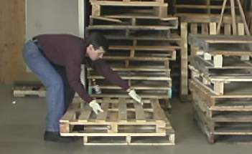
Awkward lifting
Lifting above the shoulders, below the knees or at arms’ length
Notes:
Lifting even moderate loads while bent over or reaching up or out can also place you at risk of injury, to either your back or your shoulders. When you bend over to pick something up from below your knees, not only does your back have to lift the object, but it also has to lift the weight of your upper body. Something else to keep in mind, the same stresses are there when you lower something as when you lift it.

Slide 18
Alternatives to lifting
Use carts, handtrucks, hoists, conveyors or other mechanical assistance
Slide objects instead of lifting them
Store heavy items where you won’t have to bend or reach to lift them
Use forklifts or other mechanical equipment to get items down from high shelves
Notes:
Look for alternatives to lifting, including hand trucks, carts and other mechanical assistance. If you can roll, drag or slide something instead of lifting and carrying it, often times that will be better for your back. Avoid storing things on the floor unless you use a hand truck to move them, and avoid storing heavy items above your shoulders. Place them on a surface between knee and waist level, instead. If you do have to lift, plan the lift first, know where you’re going with something before you pick it up, and make sure you have a clear path and a good place to put it down. Check the weight of the load before you pick it up. Bring the load as close to you as possible before you lift it, and keep it close as you carry it and put it down. If you can bring it between your knees and lift with your legs, that’s best. Keep your chest up and stick your hips out to minimize stress on your back. Lift smoothly and move your feet; don’t twist as you lift. If something is too large or heavy for you to comfortably lift on your own, get help.
(Try this exercise: Have someone in the class demonstrate their lifting technique on a box or another object. Have the rest of the class comment on what they did well and what they did that could increase their risk of injury.)

Slide 19
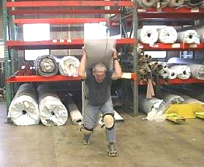
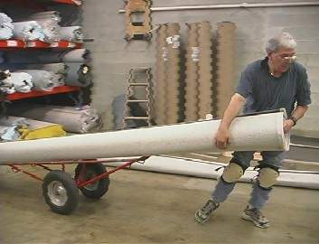

Ergonomics at Work
Risk of injury - Heavy lifting
Cart reduces risk of injury
Notes:
These pictures show the difference between lifting and moving something heavy and awkward by hand (in this case a roll of carpet) and moving the same thing with the help of a co-worker and mechanical assistance (in this case a carpet dolly).
Lifting the carpet without assistance might create a risk for back or shoulder injury. The science of ergonomics teaches us that using the dolly puts a lot less strain on the back and shoulders, and it’s also less tiring overall. The worker who gets help is a lot more likely to have a little energy left at the end of the day, and in the long run is a lot less likely to have injuries and miss work.
Ergonomics can be as simple as using a dolly to move something instead of lifting by hand. Ergonomics is about making jobs easier and reducing the risk of injury.

Slide 20
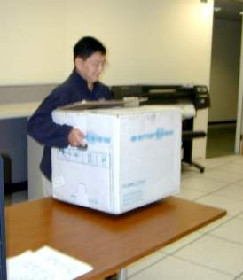
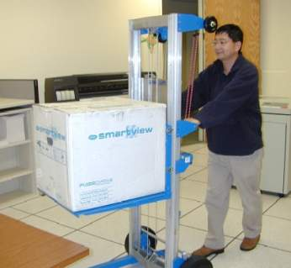
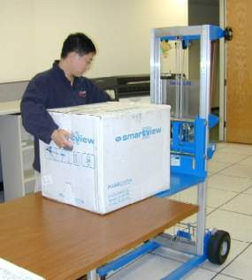
Ergonomics at Work - Reducing heavy lifting
Mechanical assistance
Notes:
Job: lifting electronic equipment in a holding area
Solution: stacker, which is like a hand truck with a height adjustable platform. This converts the lift into a slide, and then a push.

Slide 21
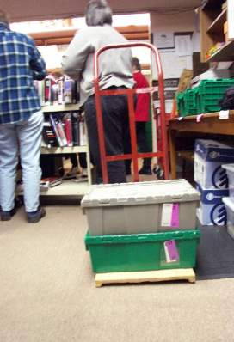
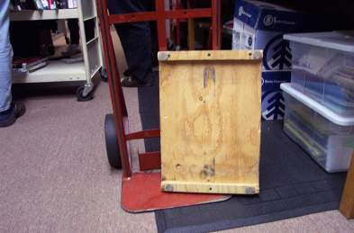
Ergonomics at Work - Reducing awkward lifting
Mini-pallet for hand truck
Notes:
This is a simple and effective idea from a library to help with moving tote boxes full of books. Rather than having to lift boxes to stack them on the hand truck, they built these “mini-pallets” out of ½” plywood and 1x1 risers. This allows the hand truck nose plate to slide easily under the stack of totes.

Slide 22
Risk factors for WMSDs
Awkward postures
Extended reaching
Bending or twisting of the trunk
Working with arms away from the body
Kneeling or squatting
Notes:
Awkward Postures

Slide 23
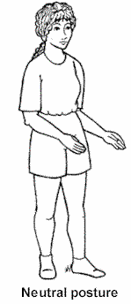
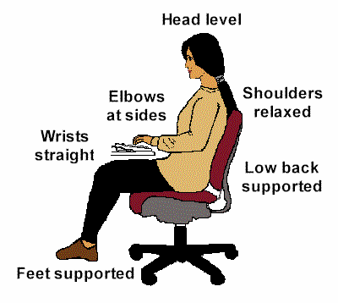
Neutral Posture
Seated neutral posture
Standing neutral posture
Notes:
To understand what an awkward posture is, it helps to understand what it isn’t. A good posture is one that places the least amount of stress on your joints and muscles. This is referred to as neutral posture. It takes the strain out of your muscles and joints and allows them to work more efficiently.
This is what standing neutral posture looks like:
Keep all the parts of your body aligned - ears directly over shoulders, shoulders over hips, hips over knees, knees over ankles.
Look straight ahead with your head level, not twisted or bent.
Relax your shoulders; don’t hunch them or rotate them forward. Let your upper arms and elbows hand comfortably at your sides.
Keep your wrists straight and in a handshake position.
Stand with your legs straight, but with our knees relaxed, not locked back.
Seated neutral posture is pretty much the same, except:
Support your low back using the chair’s backrest.
Support your feet by placing them flat on the floor or on a footrest, with your knees slightly lower than your hips.
While neutral posture places the least stress on your body, it wouldn’t be good for you to stay in that position all day. Your body was designed to move around and is much happier when it’s active.

Slide 24
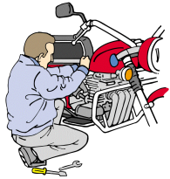
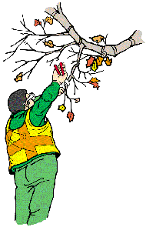
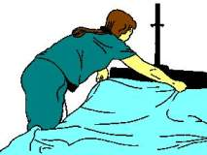
Awkward Posture
Too high
Too low
Too far away
Notes:
Work puts you into awkward postures when it’s either too low, too high, or too far away from you.

Slide 25
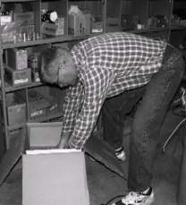
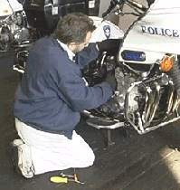
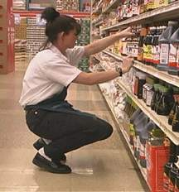
Awkward Postures - Low work
Bending
Kneeling
Squatting
Notes:
If the location of your work is too low, you’re going to have to get into an awkward posture to get to it. Typically that means bending your back, kneeling or squatting. It can also mean bending your head and neck forward.
If ergonomics is about adapting the work to fit you, instead of asking you to adapt to the work, what do you think some ergonomic solutions might be?

Slide 26
Reducing low work
Raise and/or tilt the work for better access
Use a stool for ground level work
Use tools with longer handles
Alternate between bending, kneeling, sitting, and squatting
Notes:
If the work is too low, one solution to consider is finding a way to raise the work.
If that’s not possible, can you use a low stool to provide support so that you can sit lower near the level of the work?
Long-handled tools can be used in some cases so that you can stand upright and work.
If none of the above will work, it at least helps some to alternate between different postures, so that you don’t spend too much time in any one position.

Slide 27
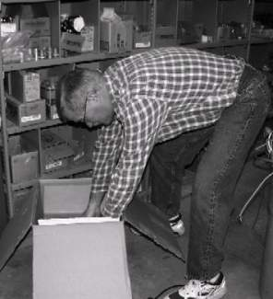
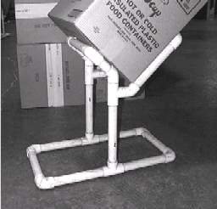
Ergonomics at Work - Reducing low work
Raise and tilt the work
Notes:
This is one example of a simple way to raise and tilt lightweight boxes for easy loading and unloading. It’s a box stand made out of PVC pipe. For $20 worth of pipe and glue, and a little time measuring and cutting with a hacksaw, some workers were able to make their jobs a little easier.

Slide 28
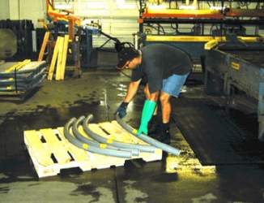
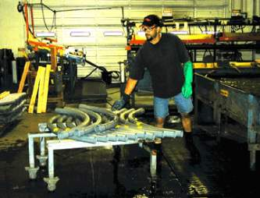
Ergonomics at Work - Reducing low work
Raise the work
Notes:
This is another example, where some workers decided it would be easier to stack lengths of pipe at the end of the process if they raised the stack a little. Placing the stack on a homemade wheeled cart makes it easier to move to the next step.

Slide 29

Awkward Postures - High work
Notes:
If your work is too high, it will result in reaching with your hands overhead or your elbows above your shoulders. It can also result in having to tilt your head back to look up.

Slide 30
Reducing high work
Use an elevated work platform or rolling stairs
Use tools with longer handles
Limit overhead storage to infrequently used items
Bring the work down and tilt for easier access
Notes:
Here are some simple ways to reduce working up high:
Use an elevated work platform or rolling stairs (“safety ladder”)
Use tools with longer handles
Limit overhead storage to infrequently used items
Bring the work down and tilt it for easier access

Slide 31

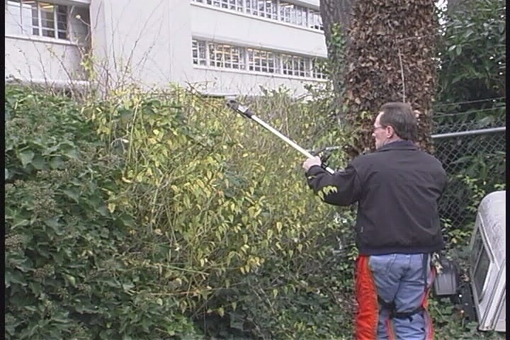
Ergonomics at Work - Reducing high work
Use a tool with longer handles
Notes:
Our groundskeeper has gone from using a standard hedge trimmer to one with an extension handle. The trimmer at the top has an adjustable angle. Long-handled tools need to be kept as light as possible, to avoid straining the hands and wrists. Look for lightweight materials such as aluminum.

Slide 32
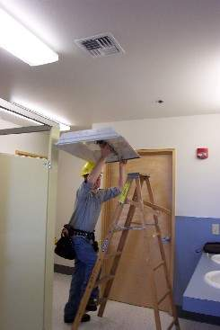
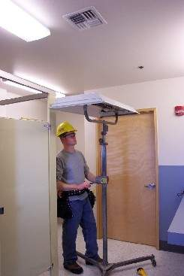
Ergonomics at Work - Reducing high work
Fixture lift for overhead applications
Notes:
This product is called a “fixture lift”. It is used to raise and stabilize products which need to be worked on overhead.

Slide 33
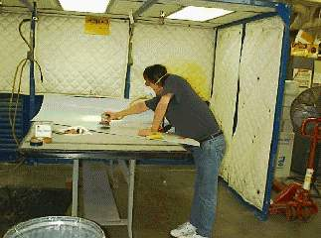
Awkward Postures - Reaching
Notes:
When work is too far away, it results in reaching outside of your comfortable reach zone.
Demonstrating Comfortable Reach Zones:
Have a short person in the class stand up with one shoulder against a flipchart or white board. With a marker in the hand closest to the chart or board, have them draw an arc with their arm out straight (but standing upright and not over-reaching), raising it from hip height up to just above their head. This line shows their maximum reach without bending. Now have a tall person come up and stand in the same spot and do the same thing. They should have an arc that is further away than the shorter person did.
Ask the class: “What do you think would happen if the tall person laid out a workspace that’s comfortable for him (or her) and then you asked the shorter person to work at it?”

Slide 34
Reducing Reaching
Keep items within close reach
(design reach distance for the shortest worker)
Remove obstacles
Use gravity feed racks
Notes:
Simple ways to reduce reach distances:
Keep items within close reach (design reach distance for the shortest worker)
Remove obstacles
Use gravity feed racks (these are racks on shelves with little wheels that allow boxes stored on them to slide forward as the front box is removed. Kind of like taking a can of pop out of the cooler case at a convenience store.)

Slide 35
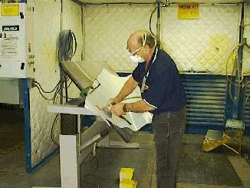
Tilt table for sanding
Ergonomics at Work - Reducing reaching
Notes:
This is an example of a remedy for reducing the reach in a sanding task, by replacing the table with one which electronically raises/lowers, and tilts. This results in bringing the material closer to the sander reducing his or her bending.

Slide 36
Risk factors for MSDs
Hand Intensive Work
Notes:
Awkward Postures

Slide 37
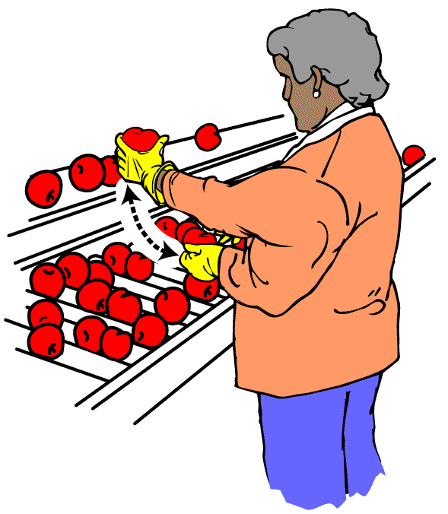
Hand Intensive Work
Repetitive motions

Slide 38
Hand Intensive Work –
Highly repetitive motion
Making the same motion repeatedly can cause a lot of wear and tear on the joints being used, and if you don’t rest to allow time for them to heal, the damage can just keep building up.
Notes:
Motions are considered highly repetitive when you use the same part of your body to make an identical motion over and over again without pauses. Most repetitive motions involve the hand, wrist, arm and shoulder, but there are also repetitive motions of the neck and back.

Slide 39
Reducing repetition
Arrange work to avoid unnecessary motions
Let power tools and machinery do the work
Spread repetitive work out during the day
Take stretch pauses
Rotate task with co-workers if possible
Change hands or motions frequently
Notes:
Repetitive motions may be required by your job. However, a lot of times you have some control over what motions you make and how often you make them. Things you can do to reduce repetitive motions include:
Arrange work to avoid unnecessary motions
Let power tools and machinery do the work
Spread repetitive work out during the day
Take stretch pauses
Rotate tasks with co-workers if possible
Change hands or motions frequently

Slide 40
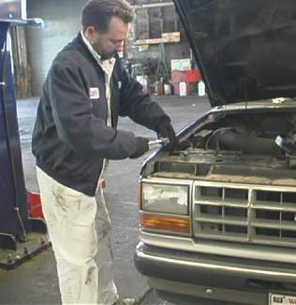
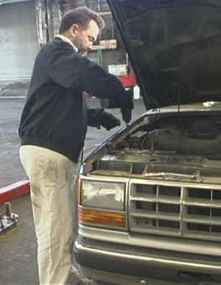
Use power tools
Ergonomics at Work - Reducing repetition
Notes:
Here’s an example of someone using a ratchet wrench to loosen and tighten bolts, and then using a small power wrench to do the same job. You can see that it doesn’t require repetitive motions, and it’s also a lot quicker. Can anyone see any risk factors that the new tool creates, though? There are some awkward postures due to the type of tool being used. However, since it’s so much faster to use, the posture may not be a problem.

Slide 41

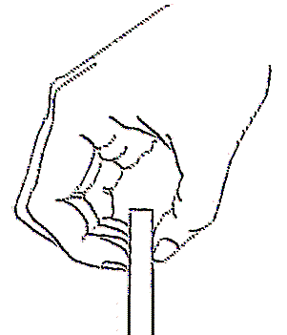
Hand Intensive Work –
Gripping and Pinching
A power grip is 5 times stronger than a pinch grip
=
10 lbs
2 lbs
Notes:
The amount of force required to grip something depends on a number of factors; one of the most important of these is how you grip it. Gripping something with the whole hand, called a power grip, is up to 5 times stronger than gripping something with the fingertips, known as a pinch grip. So, picking up something that weighs 2 pounds with a pinch grip is just as stressful as picking up 10 pounds with a power grip.
Examples, pinch grip:
Pulling large files
X-ray storage
Assembly
Musicians
Examples, power grip:
Fisheries
Carpenters
Staple guns

Slide 42
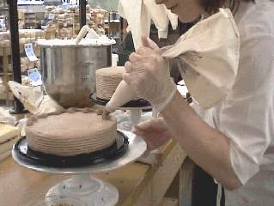
Hand Intensive Work – Gripping
Notes:
Gripping with the whole hand can be a problem if what you are gripping is relatively heavy, such as a tool that weighs more than 10 pounds. Lighter objects may also require a lot of grip force, in other words, squeezing with a force of more than 10 pounds. One example is the cake decorator using a pastry bag filled with thick frosting.

Slide 43
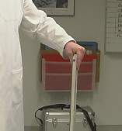
Pinching with the fingertips
Notes:
Pinching uses much smaller muscles in your hand, so picking up a 2 pound weight this way can be considered high force. It actually takes 4 lbs. of pinch force to hold a 2 lb object in order to keep it from slipping through your fingers. You see pinching when using small tools or holding flat objects, such as the x-ray cassettes in this example.

Slide 44
Other factors
Your grip strength decreases when you:
  Bend your wrists
  Pick up slippery items
  Wear poorly fitting gloves
  Have cold hands
Notes:
When you bend your wrists, you actually lose a significant amount of your grip strength. This increases your risk of injury, especially to the wrist and elbow.
(Try this exercise: Have every other person in the room grip a pencil in their hand with their wrist straight. Have the person next to them try to pull it out. Now have the person with the pencil bend their wrist and have the other person try to pull it out again. They should be able to pull it out much more easily this time.)
Other things can increase the amount of force needed to hold an object, such as if it’s slippery, or if you wear loose fitting gloves or your hands are exposed to cold, any of which make it difficult to feel what you are gripping.

Slide 45
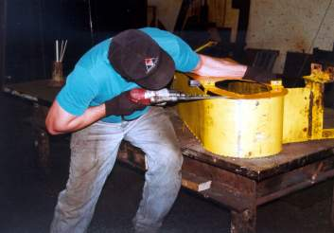
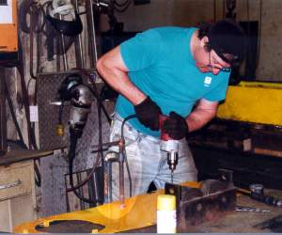
Ergonomics at Work - Reducing gripping
Use a clamp or vise to hold parts
Notes:
Here’s an example of someone working on a part drilling holes. On the left, he’s holding it with his left hand while drilling with his right. He has to counteract the force he’s applying with the drill by pulling back with his left hand, so he’s probably using even more force with his left hand than his right.
In the picture on the right, he’s got the part laid flat and he’s clamped it to the work bench. Now he can use both hands on the drill, so the force on each hand is cut in half. He’s also able to lean in with his body weight, and this will help reduce the strain on his arms.

Slide 46
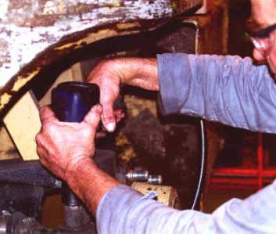
Hand Intensive Work –
Bent Wrists
Notes:
Remember that bending your wrists decreases your grip strength and making wrist and elbow injuries more likely.

Slide 47

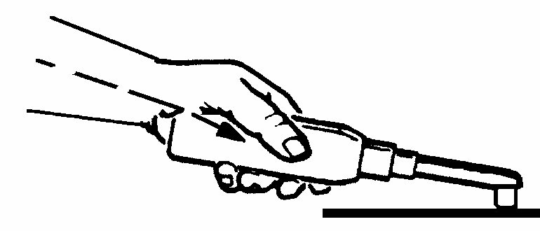
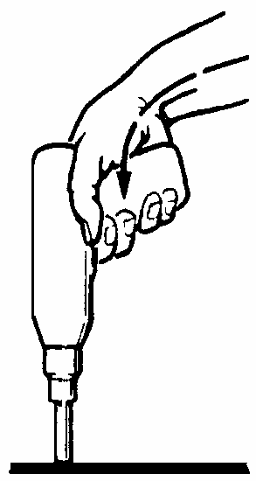
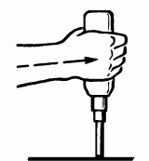
Tool use example
Use tools that let you keep your wrist straight
Working with bent wrists decreases grip strength
Notes:
When risk factors combine they are more likely to cause injury. For example, when you combine high hand force with bent wrists, an awkward posture, you’re more likely to have a wrist injury.
Here’s an example of using a power tool with the wrist bent. He still needs to apply the same amount of force to get the job done, so he actually has to use more grip force than if his wrist were straight.
He could reduce his risk of injury by using a different tool that allows him to keep his wrist straight, or moving the part into a different position so that he can use this tool with his wrist straight.

Slide 48
Hand Intensive Work – Combinations
Repetition
Gripping or Pinching Bent wrists
Repetition
Gripping or Pinching
Repetition
Risk of injury goes up as you combine factors
Risk
Notes:
Any combination of the three risk factors for injury in hand intensive work – repetition, gripping/pinching, and bent wrists – will increase your risk of injury if they occur at the same time. Having all three at once creates the highest risk of injury. If you can’t reduce all of the risks, it will help you even if you reduce only one of them.

Slide 49
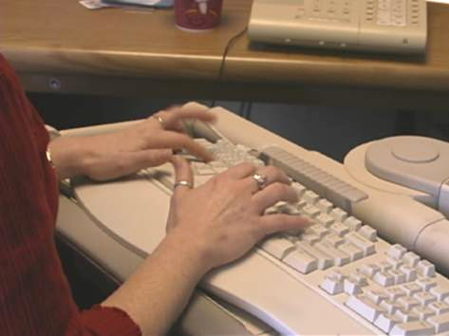
Intensive keying
Notes:
Intensive keying, as opposed to intermittent keying, is a special kind of repetitive motion. It involves highly repetitive movements of the fingers for a long duration - four or more hours per day - doing tasks like data entry or transcription. While your fingers are moving rapidly, the rest of your body is essentially held in one position. The repetitive movements create a risk for hand or wrist injuries. However, intensive keying can be stressful for your whole body, especially if you work in awkward postures as well.

Slide 50
Reducing intensive keying
Spread keyboard work throughout the day
Take stretch pauses
Improve your posture and move around as much as possible
Notes:
There are several things you can do to reduce risk of injury from intensive keying, including:
Use macros for common functions
Spread keyboard work throughout the day
Take stretch pauses
Improve your posture and move around as much as possible
You can apply these same principles when using your computer at home, too.

Slide 51
Risk factors for WMSDs
Vibration
Notes:
Exposure to moderate to high levels of vibration

Slide 52
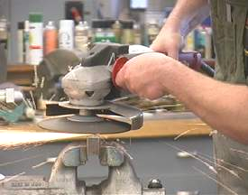
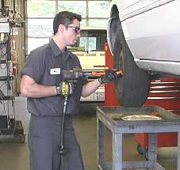
Vibration
Moderate vibration
High vibration
Notes:
Power tools can transmit vibration to the hands and arms, and this has a number of effects on the body. If you’re exposed to enough vibration, it can cause damage to the nerves and blood vessels in your hands and arms. Vibration also tends to make the muscles tighten up. The tighter you grip the tool, the more vibration gets transmitted to your hands and arms, and this makes injury more likely.
Some tools put out a high level of vibration, and this can start to have these effects on your body in as little as half an hour of use per day.

Slide 53
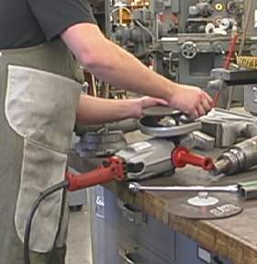
Reducing vibration
Use low vibration tools if available
Maintain tools
Use anti-vibration gloves or tool wraps
Keep hands warm
Notes:
It takes quite a bit of vibration to actually cause an injury, but if you use a lot of power tools you should take all of the steps you can to reduce your exposure to vibration. These include:
Use low vibration tools if available.
Maintain tools to reduce vibration. Well maintained tools can often get the job done quicker, too. This reduces your exposure to vibration. This is the case with the example, where he’s changing the grinding disk when it’s worn. The new pad will help get the job done more quickly.
Use anti-vibration gloves or tool wraps.
Keep your hands warm to help keep good blood flow and feeling to your hands.

Slide 54
OSHA Guidelines for
Ergonomics
OSHA has developed industry- or task-specific guidelines for a number of industries based on current incidence rates and available information about effective and feasible solutions
OSHA is conducting inspections for ergonomic hazards and issues citations under the General Duty Clause and issues alert letters where appropriate
OSHA is providing assistance to business to help them proactively address ergonomic issues in the workplace
OSHA has chartered an advisory committee to identify gaps in research and application of ergonomics and ergonomic principles in the workplace
Notes:
OSHA has developed industry-specific guidelines for Nursing Homes, Grocery Stores, Poultry Processing, and Shipyards) and describing their major components;
OSHA is conducting inspections for ergonomics hazards and has issued citations under the General Duty Clause.

Slide 55
Remember, OSHA does not have regulations to address ergonomics, only Recommendations and Guidelines
Notes:
Go to OSHA’s website and show them some of the guidelines and e-tools that are used for ergonomics. www.osha.gov
Refer to the NIOSH lifting equation, http://www.cdc.gov/niosh/docs/94-110/pdfs/94-110.pdf
Also show other available resources:
RULA Employee Assessment Worksheet. (handout copies and briefly explain)
Liberty Mutual Lifting Tables
http://libertymmhtables.libertymutual.com/CM_LMTablesWeb/taskSelection.do?action=initTaskSelection
Do not attempt to teach these tools. Just show them as a resource.

Slide 56
What you can do:
Recognize and report signs and symptoms early
Get involved in ergonomics
Notes:
Next we’ll talk about what to do if you have symptoms of a WMSD and how you can be involved in your company’s efforts to prevent these injuries from occurring.

Slide 57
Recognition and reporting signs and symptoms
Report signs or symptoms if:
  Pain is persistent, severe or worsening
  Pain radiates
  Symptoms include numbness or tingling
  Symptoms keep you from sleeping at night
  Fingers blanch or turning white
Notes:
Of course, it wouldn’t make sense to report all the little aches and pains you experience. But how do you know when symptoms are serious enough to need attention? Report your symptoms if:
Pain is persistent, severe or worsening.
Pain radiates (spreads or “travels” down an arm or leg.
Symptoms include numbness or tingling.
Symptoms keep you from sleeping at night.
Fingers blanch or turning white” that may indicate potential Hand-Arm Vibration Syndrome
When in doubt, it’s better to report symptoms and be told there’s nothing wrong than to wait too long.
(Discuss your company’s specific reporting policy with the employees at this point.)

Slide 58
Why is it important to report signs and/or symptoms early?
Acute injuries can easily become chronic injuries and can sometimes lead to disability, even surgery
Early treatment save time and money
Notes:
Some WMSDs can be very serious, resulting in lost work days, permanent disability, or even surgery. However, the good news is that early treatment is often very simple and successful. Therefore, it’s important for your own health to report symptoms as early as you can.

Slide 59
Getting involved
Look at jobs
Come up with solutions
Work with solutions
Take part in training
Take responsibility for changing the way you do your job
Help to make sure efforts are successful
Notes:
Now that you’ve learned something about ergonomics you can get involved. Your employer may ask you or some of your co-workers to be involved in our efforts to prevent WMSDs. For example, you may be asked to help look at jobs with risk factors to see if hazards exist. Your input can be very helpful, since you are the expert on your job.
If jobs are found to be hazardous, you may be asked to take part in coming up with solutions. If you have any ideas on how to fix the job, share them with us. If changes are made to your job, do the best you can to work with those changes since they’re there for your safety. Once you get used to the changes you may find that they actually make your job easier. Take part in any training that comes along with the changes, so you’ll be able to adapt quickly. Your work habits are important, too, so you may need to change the way you do some parts of your job so that you can do them more safely. You should also try to apply the principles of ergonomics you learn to your home life as well. Finally, make sure you let us know whether the changes have worked or not.

Slide 60
Five key points to remember
Ergonomics can help you on your job
WMSDs can happen in jobs with risk factors
Risk factors can be reduced and WMSDs prevented
Reporting signs and symptoms early is important
You can help your company put ergonomics changes into place
Notes:
In summary, here are six key points to remember about ergonomics:
Ergonomics is a tool you can use to make your job safer and better.
Washington state has a rule that requires some employers to implement ergonomics in the workplace.
In jobs with enough exposure to risk factors, work-related musculo-skeletal disorders, or WMSDs, can occur.
By applying ergonomics, risk factors can be reduced and WMSDs prevented.
We can’t stress this point enough: If you start having symptoms of a WMSD, be sure you report them early to avoid more serious injury.
You are the expert when it comes to your job, and you can play an important role in your company’s ergonomics efforts. Ergonomics can be more than just a one-time fix. It can be an on-going process that you and your employer can use to make things better.
Thank you for your attention.

Slide 61
Body Mapping Exercise
  Answer questions 1 – 4 using your own personal experience.
  Once all groups are done, then answer question 5
Notes:
Hand out body mapping exercise
Be sure class is broken up according to job. (if you are dealing with people that are all from the same job category, break them into different tasks within the job.)
Leave slide up while the groups are working on this activity.
Give about 15 minutes to answer questions 1 – 4.
Groups presenting pain should take no more than 5 minutes each (4 groups)
Allow 15 minutes to answer question 5
And another 5 each to go over #5.
Make sure groups understand what is going on by physically going up to each group and checking their progress.

